Slide 1
Unit-1 Overview and Word Level Analysis

Slide 2
Introduction to Natural Language Processing
Humans communicate with each other using words and text. The way that humans convey information to each other is called Natural Language.
Every day humans share a large quality of information with each other in various languages as speech or text.
However, computers cannot interpret this data, which is in natural language, as they communicate in 1s and 0s.
The data produced is precious and can offer valuable insights. Hence, you need computers to be able to understand, emulate and respond intelligently to human speech.
Natural Language Processing or NLP refers to the branch of Artificial Intelligence that gives the machines the ability to read, understand and derive meaning from human languages

Slide 3
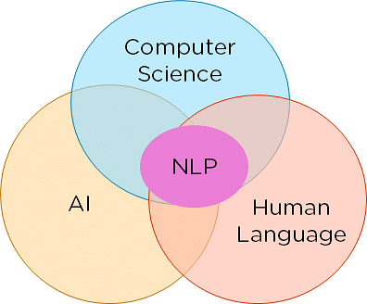
NLP combines the field of linguistics and computer science to decipher language structure and guidelines and to make models which can comprehend, break down and separate significant details from text and speech
Definition:
NLP is a branch of artificial intelligence that deals with analyzing, understanding, and generating the languages that humans use naturally in order to interface with computers in both written and spoken contexts using natural human languages instead of computer languages.
Natural language simply refers to the way we communicate with each other: speech and text.
Processing refers to making natural language usable for computational tasks.
Figure 1: Constituents of NLP

Slide 4
Natural Language Processing (NLP) is a field of computer science and artificial intelligence that focuses on the interaction between computers and humans using natural language. It involves analyzing, understanding, and generating human language data, such as text and speech.
NLP has a wide range of applications, including sentiment analysis, machine translation, text summarization, chatbots, and more. Some common tasks in NLP include:
Text Classification: Classifying text into different categories based on their content, such as spam filtering, sentiment analysis, and topic modeling.
Named Entity Recognition (NER): Identifying and categorizing named entities in text, such as people, organizations, and locations.
Part-of-Speech (POS) Tagging: Assigning a part of speech to each word in a sentence, such as noun, verb, adjective, and adverb.
Sentiment Analysis: Analyzing the sentiment of a piece of text, such as positive, negative, or neutral.
Machine Translation: Translating text from one language to another.

Slide 5
Applications of NLP
Machine translation(Google Translate)
Natural language generation
Web Search
Spam filters
Sentiment Analysis
Chatbots

Slide 6
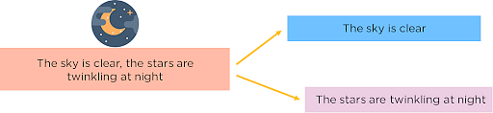
How to Perform NLP?
The steps to perform preprocessing of data in NLP include:
Segmentation:
You first need to break the entire document down into its constituent sentences. You can do this by segmenting the article along with its punctuations like full stops and commas.

Slide 7
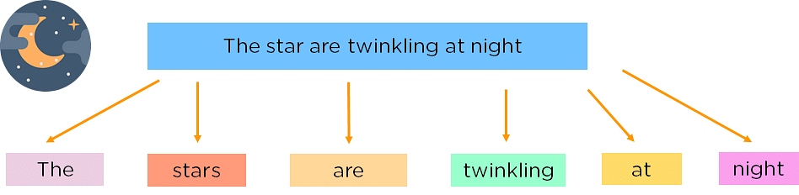
Tokenizing:
For the algorithm to understand these sentences, you need to get the words in a sentence and explain them individually to our algorithm. So, you break down your sentence into its constituent words and store them. This is called tokenizing, and each world is called a token.

Slide 8
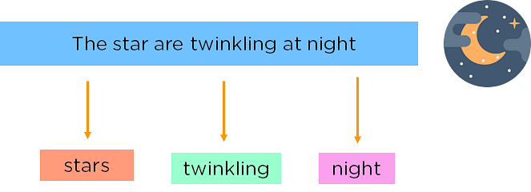
Removing Stop Words:
Can make the learning process faster by getting rid of non-essential words, which add little meaning to our statement and are just there to make our statement sound more cohesive. Words such as was, in, is, and, the, are called stop words and can be removed.

Slide 9
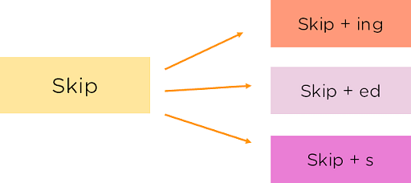
Stemming:
It is the process of obtaining the Word Stem of a word. Word Stem gives new words upon adding affixes to them

Slide 10
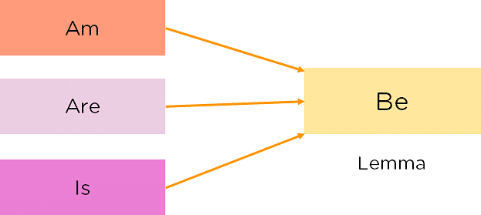
Lemmatization:
The process of obtaining the Root Stem of a word. Root Stem gives the new base form of a word that is present in the dictionary and from which the word is derived. You can also identify the base words for different words based on the tense, mood, gender,etc.

Slide 11
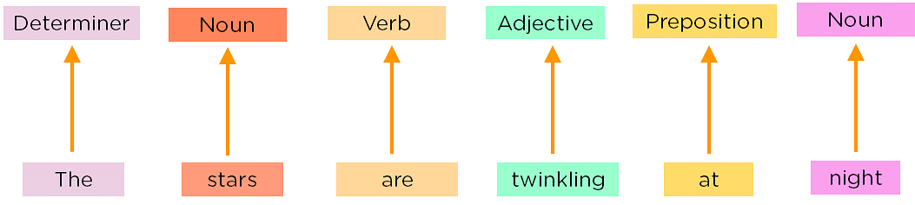
Part of Speech Tagging:
Now, you must explain the concept of nouns, verbs, articles, and other parts of speech to the machine by adding these tags to our words. This is called ‘part of’.

Slide 12
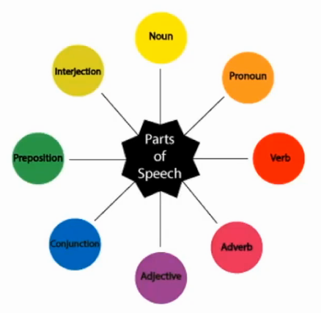
Parts of speech tags are the properties of the words, which define their main context, functions, and usage in a sentence. Some of the commonly used parts of speech tags are

Slide 13
Named Entity Tagging:
Next, introduce your machine to pop culture references and everyday names by flagging names of movies, important personalities or locations, etc that may occur in the document. You do this by classifying the words into subcategories. This helps you find any keywords in a sentence. The subcategories are person, location, monetary value, quantity, organization, movie.
After performing the preprocessing steps, you then give your resultant data to a machine learning algorithm like Naive Bayes, etc., to create your NLP application.

Slide 14
Different Levels of NLP
Natural language processing, also referred to as text analytics, plays a very vital role in today’s era because of the sheer volume of text data that users generate around the world on digital channels such as social media apps, e-commerce websites, blog posts, etc. Natural Language Processing works on multiple levels and most often, these different areas synergize well with each other.

